Slide 1
Change Making Problem
CSCI 310 Advanced Algorithms

Slide 2
Problem
The smallest number of coins from a given amount of change that needs to be returned
Notes:
Shefali

Slide 3
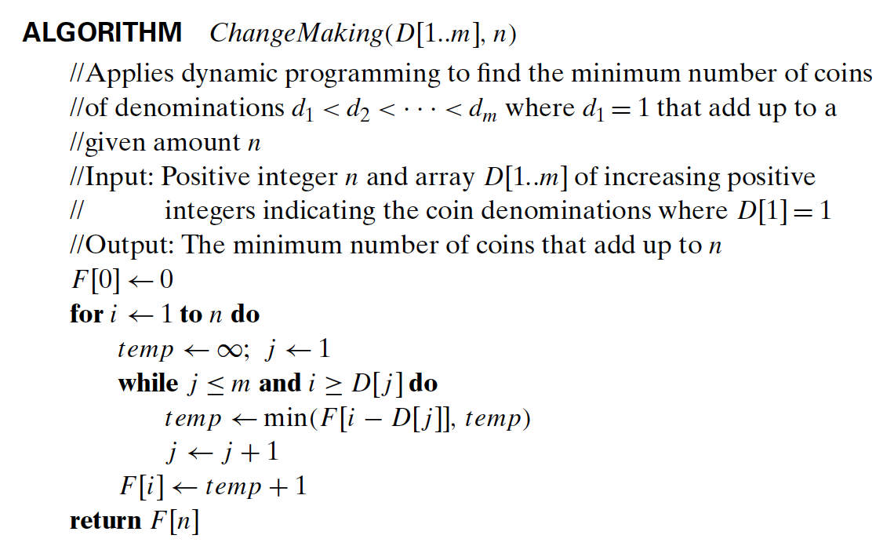
Solution

Slide 4
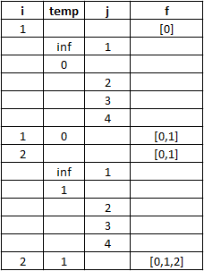
Example
Let D[] = {1, 5,10, 25}, m = 4
n = 2

Slide 5
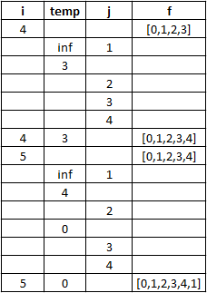
Example
Let D[] = {1, 5,10, 25}, m = 4
n = 5

